Slide 1
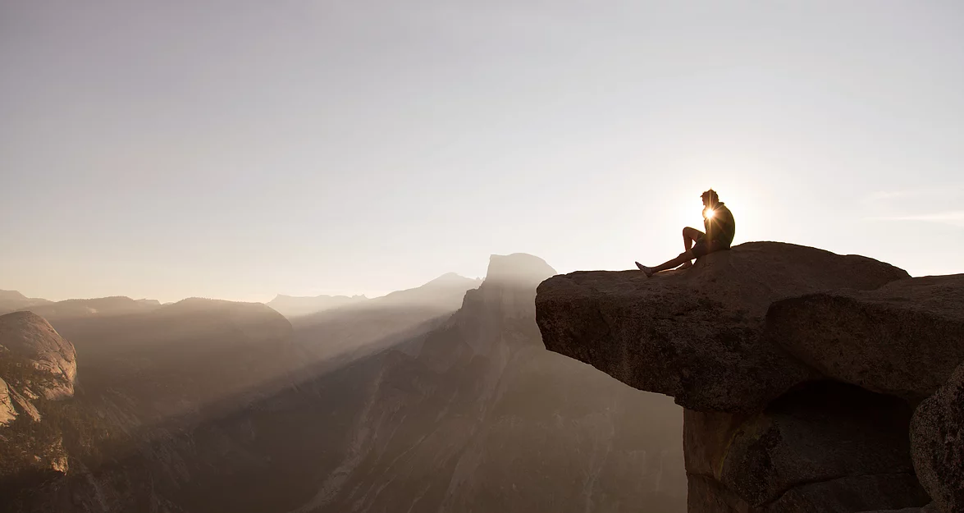
SELF ESTEEM PROGRAMME
Unleash and embrace the power of your uniqueness
* Self discovery * Self belief * Self empowerment

Slide 2
“To be yourself in a world that is constantly trying to make you something else is the greatest accomplishment.” – Ralph Waldo Emerson

Slide 3
~
WHAT IS SELF ESTEEM
It is about knowing not only what your strengths are but also
having an aware of your weaknesses. Its about embracing both of these and not allowing these perceived weaknesses to take away any degree of your self worth. For when you do so, you see mistakes and failures as a necessary part of growing and developing and they strengthen rather than weaken you.

Slide 4
~
WHY SELF ESTEEM
We live in a time where we are overloaded with information and images of who we should be, how we should live our lives and what we should even look like. Unless we have clarity of who we truly are and what is important to us, as well as embrace who we are, it becomes increasingly difficult to lead a fulfilled life that is in alignment with what is important to us.
The result of this is that we get caught up in a vicious circle of trying to do more and more to live up to these standards to feel better about ourselves. It presents itself in the form of never feeling like we have enough time or we never feel like we are enough because no matter how much we do, we still do not feel fulfilled.
It can also limit us from realizing our true and fullest potential as we are so busy leading the lives that others think we should be leading and busy trying to gain others acceptance and approval, that we lose a sense of our own self and purpose.

Slide 5
To be human is to be imperfect and to appreciate all the beauty this brings with it. For it is not others perceived perfections that allow us to connect with them deeply but rather their vulnerabilities and struggles. And in so doing, it makes us realize how we are all so much more alike than different and also intricately connected.

Slide 6
~
WHY SHOULD YOU JOIN
Gain clarity on what your unique strengths and abilities are
Learn how to acknowledge and deal with your inner critic
Stop comparing yourself to others
Learn how to set clear boundaries
Embrace and accept yourself
Gain an inner strength and strong sense of who you are which allows you to not only utilize your fullest potential but gain inner peace and fulfillment
Discover and define your own vision of success and develop the courage to live it free from fear of judgment

Slide 7
Focus your thoughts, energy and time on further developing that which you are already great at. Do not allow your inner critic to consume your thoughts and energy and detract from this focus as it does not serve you. And then watch as an abundance of peace and fulfillment creeps its way into your life and you grow into the person you truly are.

Slide 8
~
HOW IS THE PROGRAMME STRUCTURED TO DEVELOP SELF ESTEEM AND CONFIDENCE
Self Discovery: Gain clarity on your values, strengths, goals, what energizes and depletes your energy
~
Self Compassion: Identifying your inner critic and learning how to constructively deal with it
~
Affirm Self Worth: Learning how to constructively deal with setbacks and acknowledge your self worth
~
Micro – Steps: Setting small achievable micro goals and commit to action to nurture your self worth

Slide 9
~
WHAT DOES THE 6 MONTH PROGRAMME INCLUDE
12 INDIVIDUAL 1 ON 1 COACHING SESSIONS* ( 1 x 1,5 hours, 11 x 1 hour )
~
3 GROUP COACHING SESSIONS* ( 4 hours each)
~
A COMMUNITY TO SHARE CHALLENGES AND EXPERIENCES WITH
~
2 FREE WORKBOOKS
* Coaching and group sessions possible in person or via video calls

Slide 10
“Our deepest fear is not that we are inadequate. Our deepest fear is that we are powerful beyond measure. It is our light, not our darkness that most frightens us. We ask ourselves, ‘Who am I to be brilliant, gorgeous, talented, fabulous?’ Actually, who are you not to be? Your playing small does not serve the world. There is nothing enlightened about shrinking so that other people won’t feel insecure around you. We are all meant to shine, as children do. And as we let our own light shine, we unconsciously give other people permission to do the same. As we are liberated from our own fear, our presence automatically liberates others.” – Marianne Williamson

Slide 11
~
CONTACT
Contact me to find out more!
Shivani Buchner
sb@shivanibuchner.com
www.shivanibuchner.com
Participants limited to 10 per group
Next programme starting Nov 2019

